Slide 1
Bayesian Statistics
More About WinBUGS
Brani Vidakovic
Professor
School of Industrial and Systems Engineering

Slide 2
Before We Begin…
Data In
Missing Data
Testing
Prediction
Censoring
New Likelihood
New Prior

Slide 3
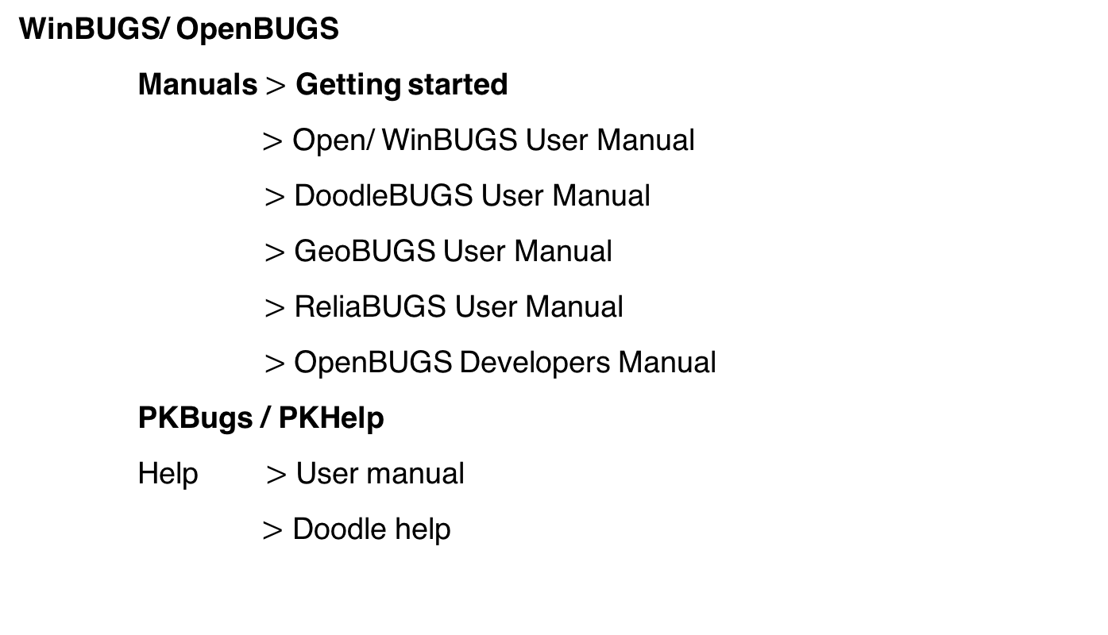
WinBUGS/ OpenBUGS
Manuals $>$ Getting started
$>$ Open/ WinBUGS User Manual
$>$ DoodleBUGS User Manual
$>$ GeoBUGS User Manual
$>$ ReliaBUGS User Manual
$>$ OpenBUGS Developers Manual
PKBugs / PKHelp
Help $>$ User manual
$>$ Doodle help
Open BUGS
Win BUGS

Slide 4
Demo
“Show and tell”, explaining WinBUGS features on examples
Focus on programming aspects, rather than statistical modeling (for now)
All examples discussed can be found in the unit repository

Slide 5
Reading in the data
cheese.odc
stressacids.odc
Missing data
dugongsmissing.odc
Testing
psoriasis.odc
equivalence.odc
Prediction
cheese.odc
Censoring
exponential1.odc
New Likelihood/ New Prior
zerotrickjeremy.odc

Slide 6
Summary

